Slide 1
SVM
SUPPORT VECTOR MACHINE

Slide 2
SVM: Support Vector Machine
In Machine Learning, Support Vector Machines are supervised learning models with associated learning algorithms that analyze data and recognize patterns, used for classification and regression analysis.
Properties of SVM :
Duality
Sparseness
Kernels
Margin
Convexity

Slide 3
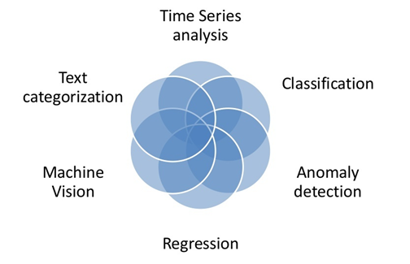
SVM Applications

Slide 4
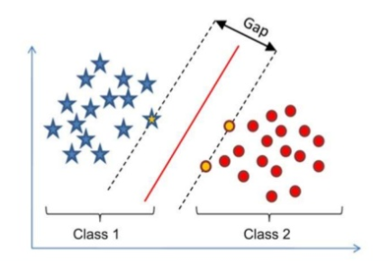

Basic Concept of SVM

Slide 5
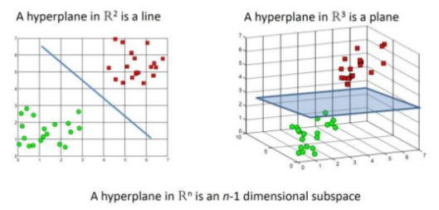
Hyperplane as a Decision Boundary
A hyperplane is a linear decision surface that splits the space into two parts;
A hyperplane is a binary classifier.

Slide 6
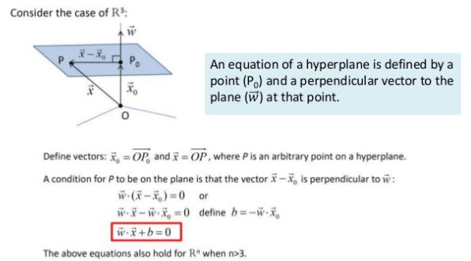
Equation of a Hyperplane

Slide 7
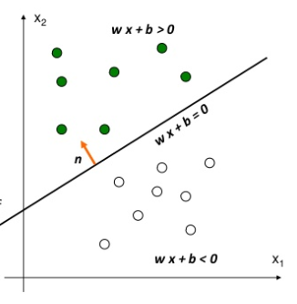

Understanding the basics
g(x) is a linear function :
A hyperplane in the feature space.
(Unit-length) normal vector of the hyperplane:

Slide 8
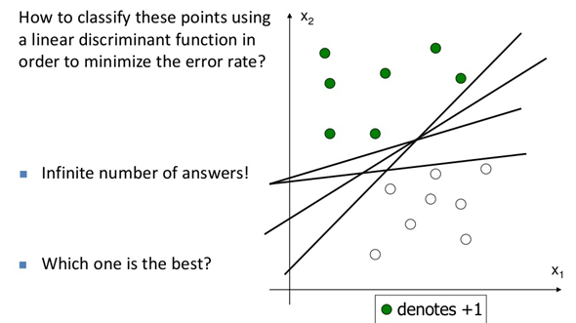

Understanding the basics

Slide 9
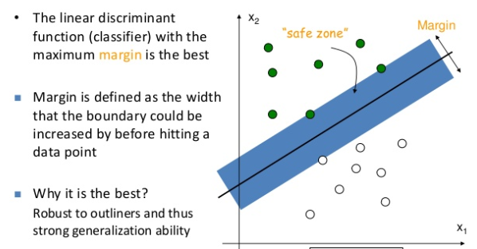

Understanding the basics

Slide 10
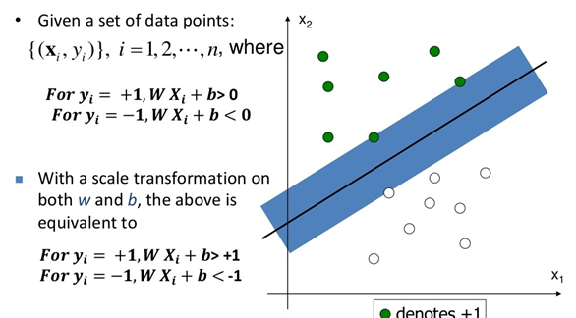

Understanding the basics

Slide 11
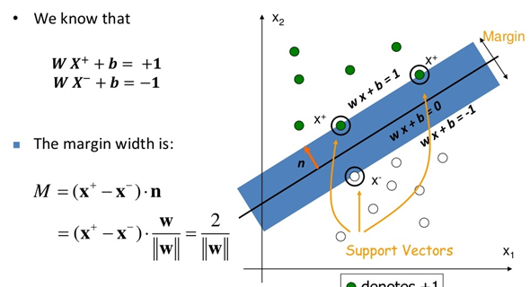
Understanding the basics

Slide 12
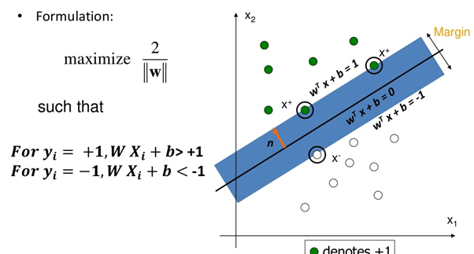
Understanding the basics

Slide 13
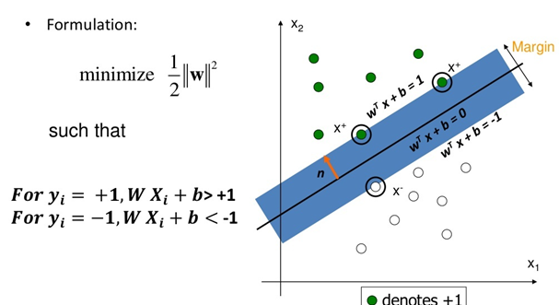
Understanding the basics

Slide 14
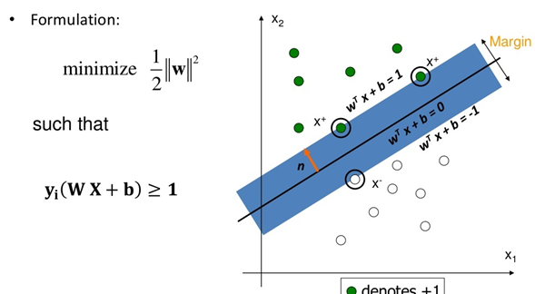
Understanding the basics

Slide 15
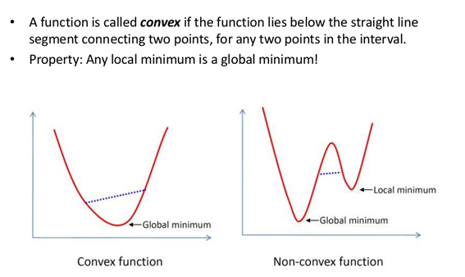
Basics of optimization: Convex functions

Slide 16
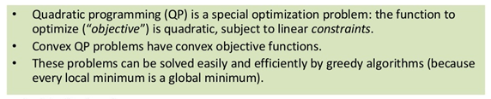
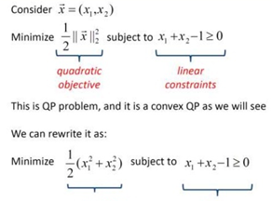
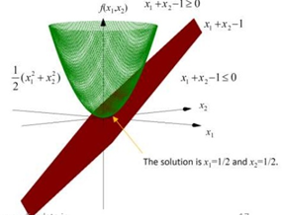

Basics of optimization: Quadratic Programming

Slide 17
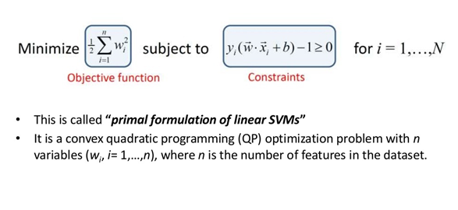
SVM optimization problem: Primal formulation

Slide 18
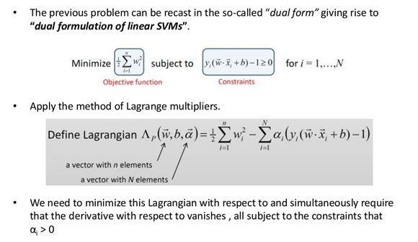
SVM optimization problem: Dual formulation

Slide 19
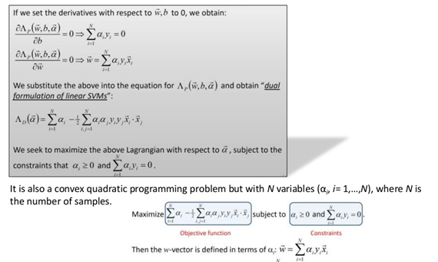

SVM optimization problem: Dual formulation

Slide 20
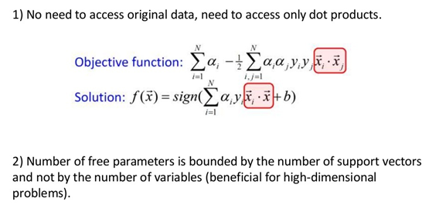
SVM optimization problem: Benefits of Using Dual formulation

Slide 21
Thank You

